Slide 1
RECLAIM
Everything is for sale

Slide 2
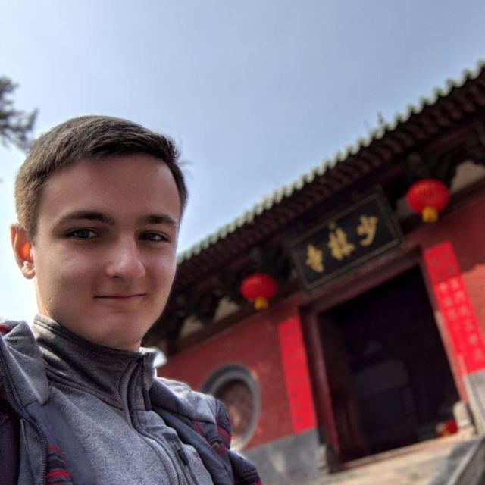

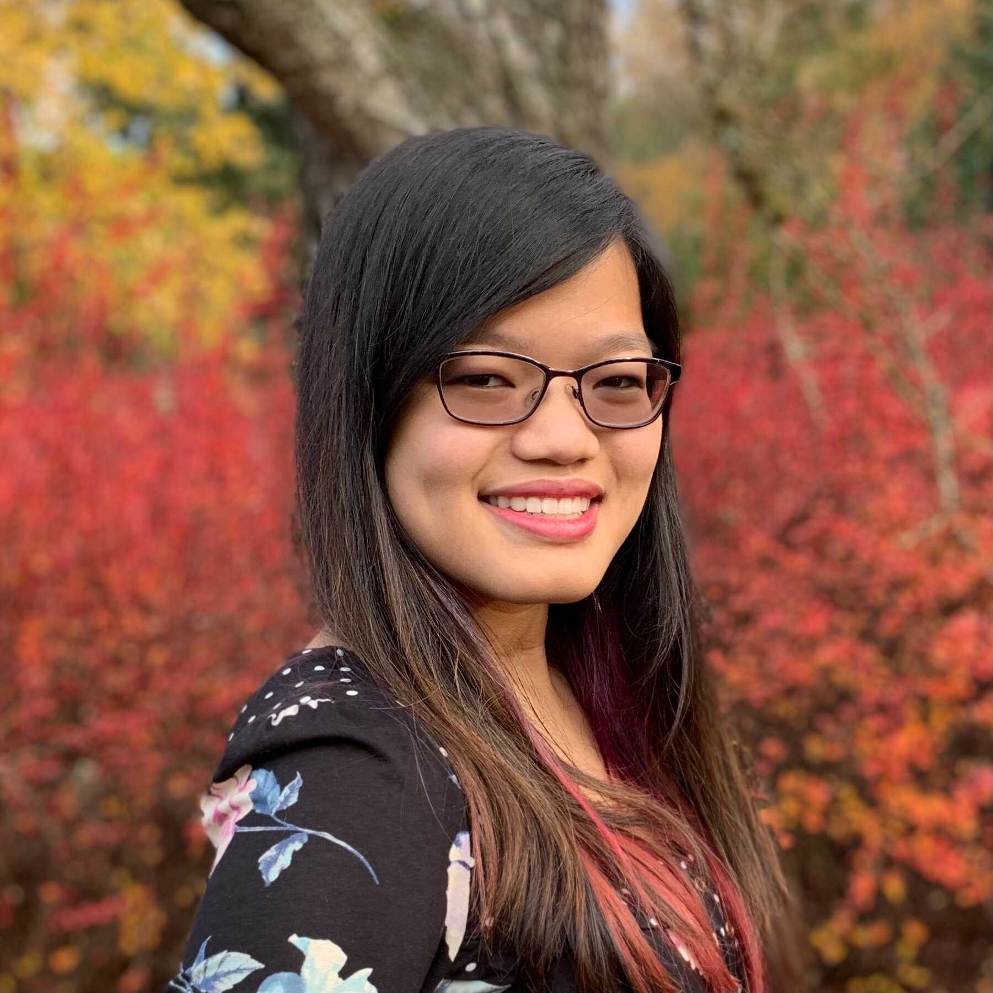
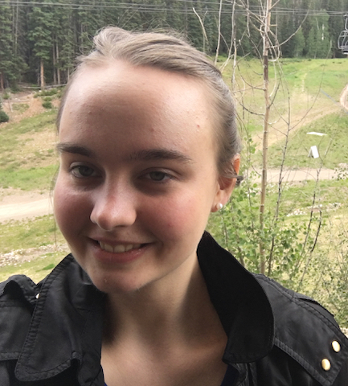
Our Team
IGOR B
MILES M
DISNEY V
MELISSA W

Slide 3
Overview
01
02
03
04
05
MISSION
INTERFACE
LO-FI PROTOTYPE
TESTING
RESULTS

Slide 4

Problem- Solution Overview
PROBLEM
SOLUTION
As a buyer, finding a local seller who is willing to sell is hard
Unlocks hidden supply for buyers
Reduces burden on sellers to manually list

Slide 5


MISSION STATEMENT
MISSION STATEMENT
VALUE PROPOSITION
VALUE PROPOSITION
To make buying used easier than buying new -- eliminating shipping
Everything is for sale

Slide 6
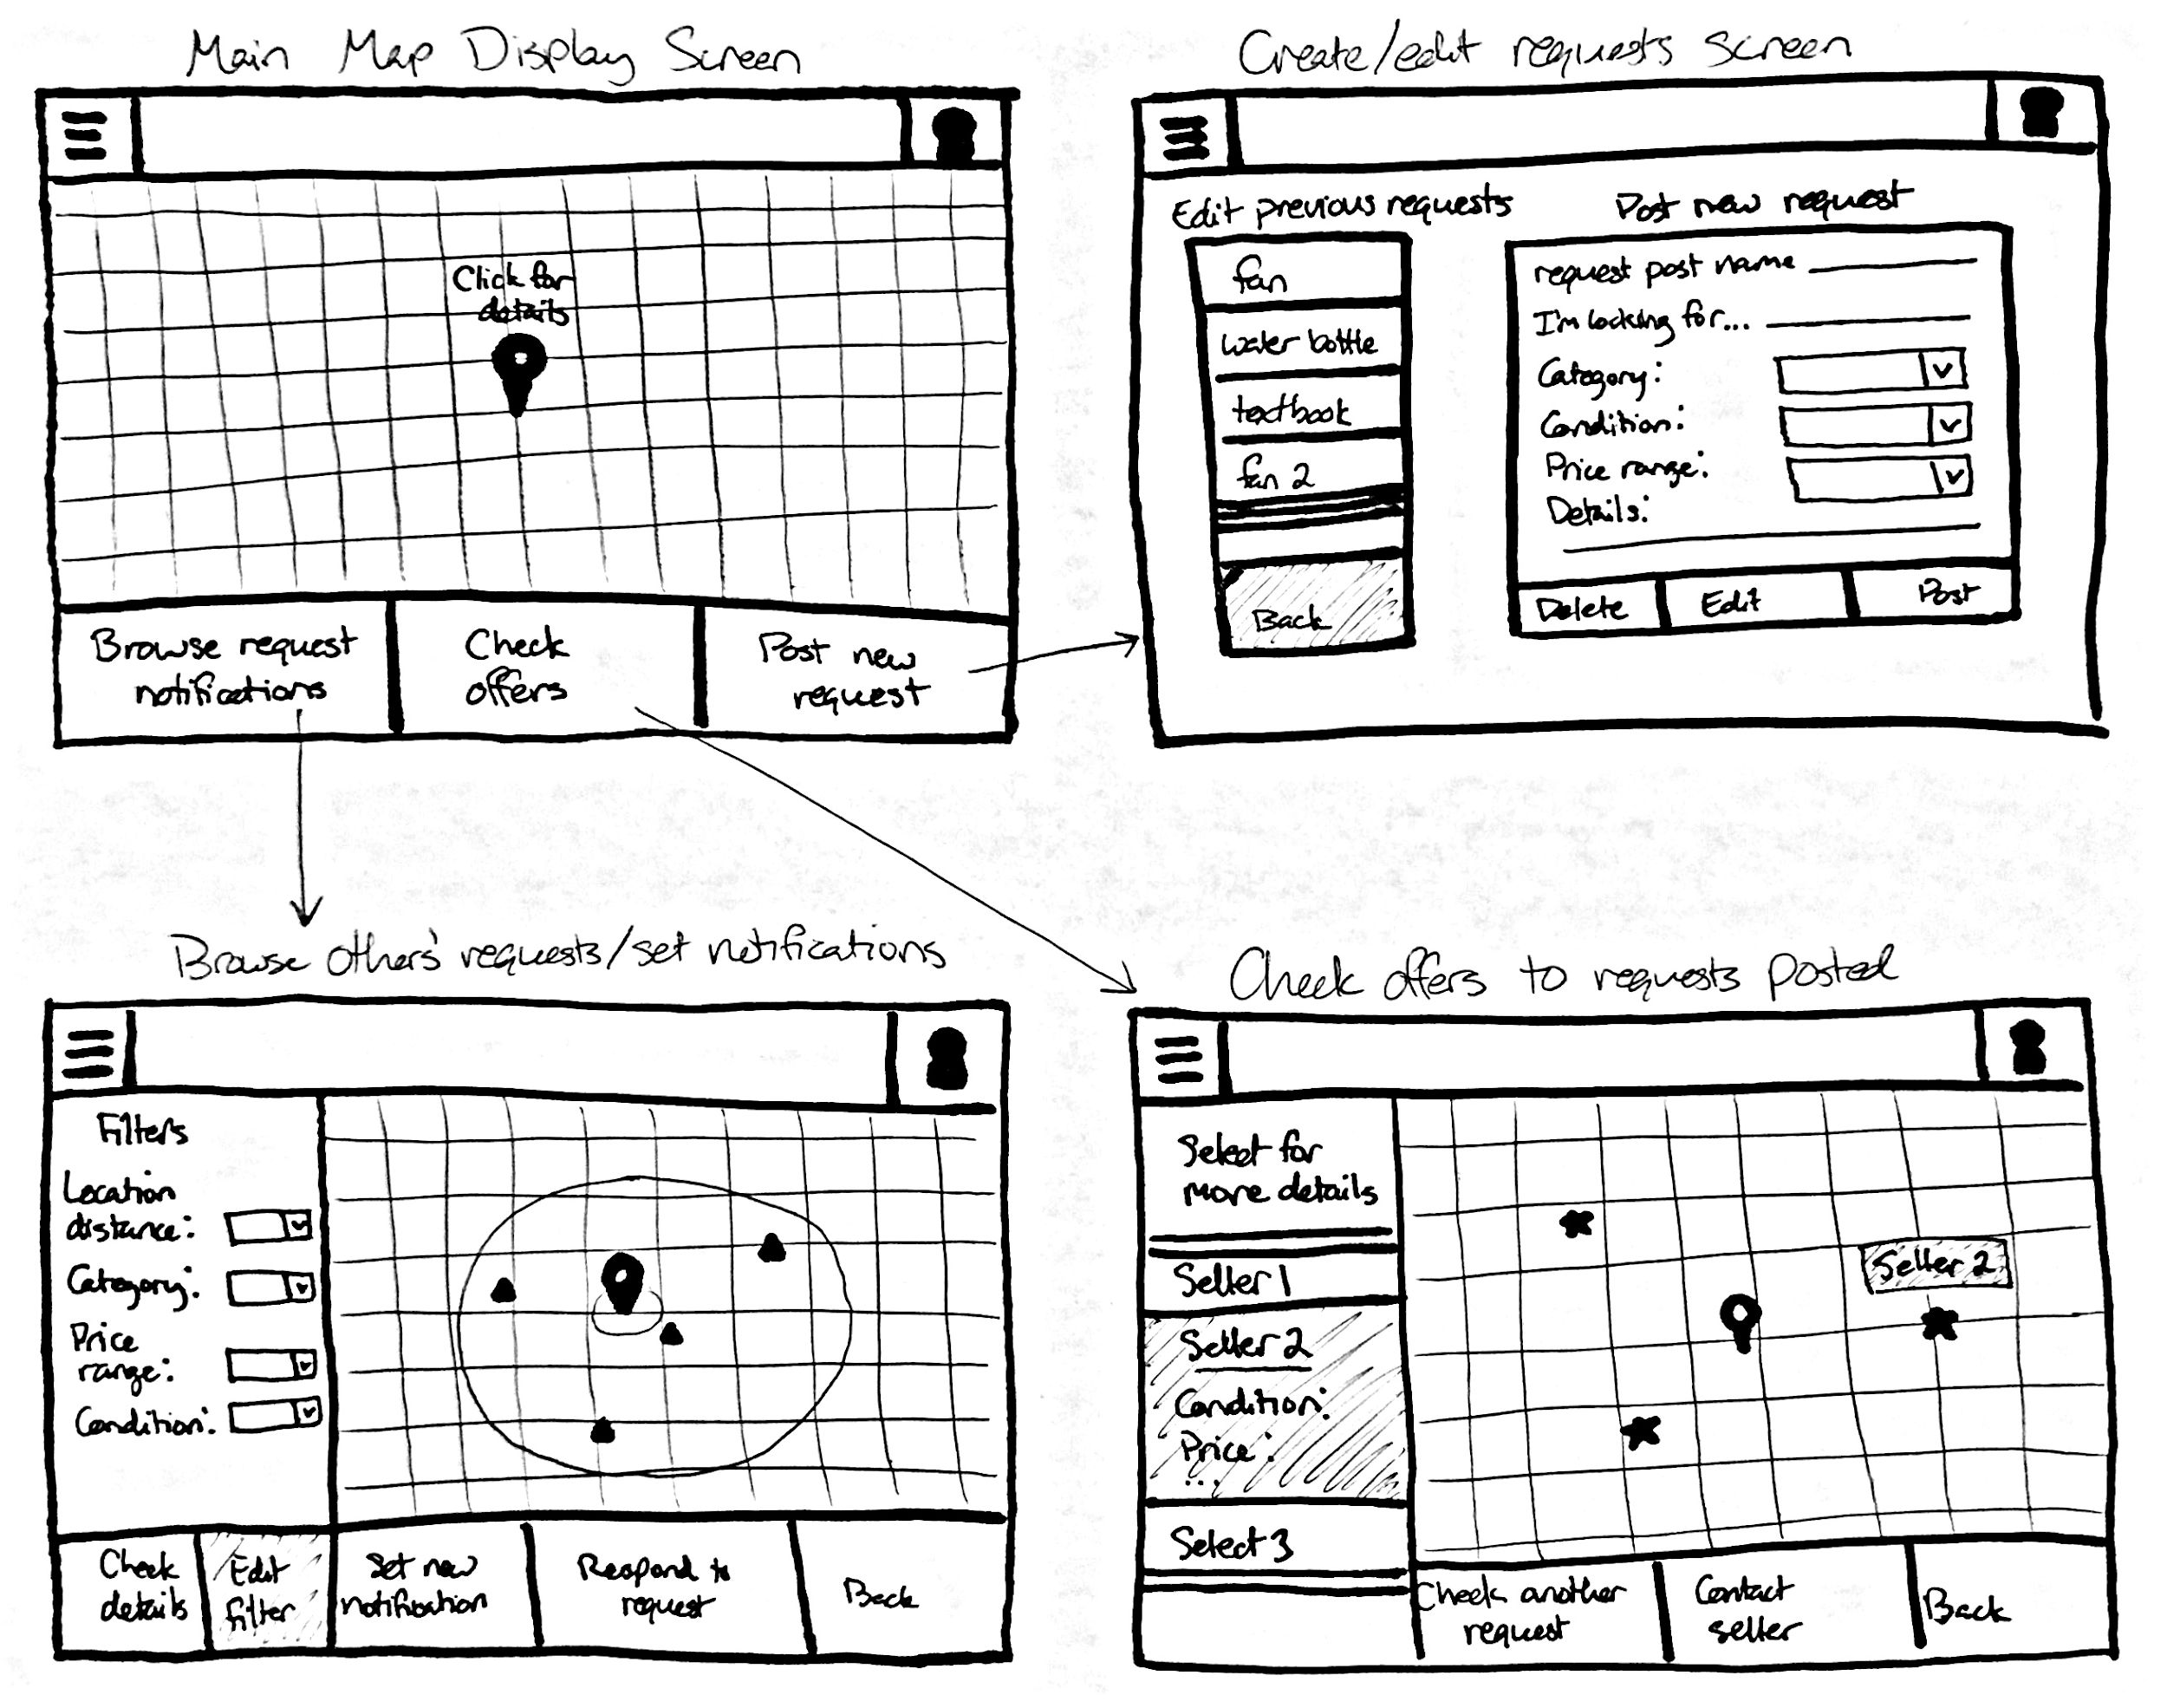
Maps-Based Interface

Slide 7
Maps-Based Interface
PROS
CONS
Emphasizes locality
Privacy concerns
Feels like a treasure map
Other types of browsing hindered
Helps find meeting place
Dense cities appear crammed

Slide 8
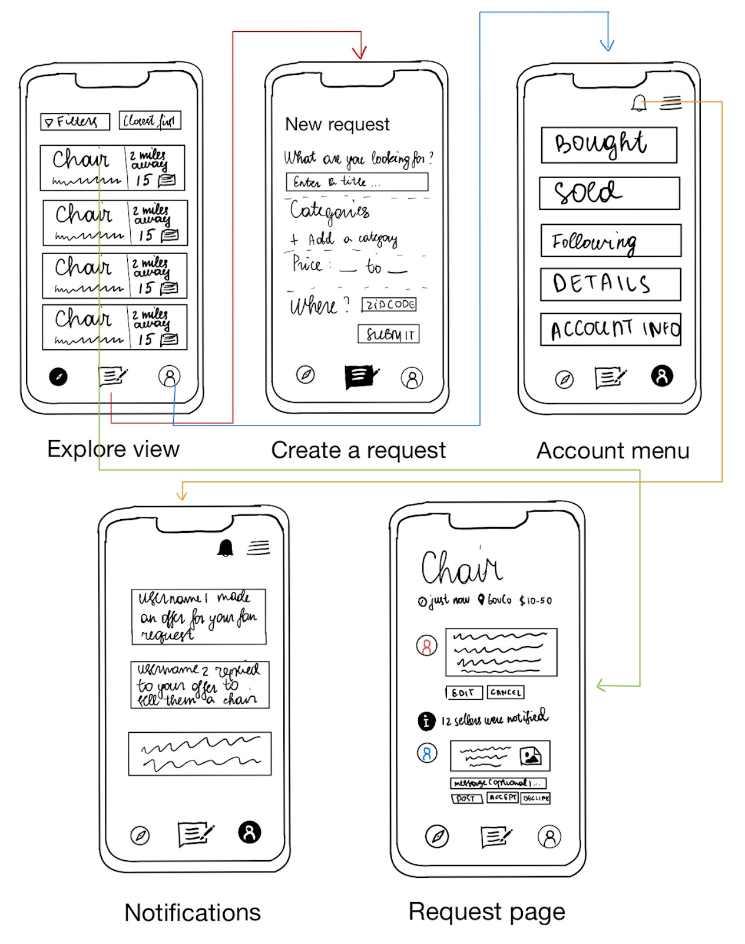
Linear Mobile Interface

Slide 9
Linear Mobile Interface
PROS
CONS
More familiar interface
Less exciting and novel
No risk of overcrowding
Does not map anything to the ‘real world’
Sorting is possible and intuitive
Does not emphasize locality

Slide 10
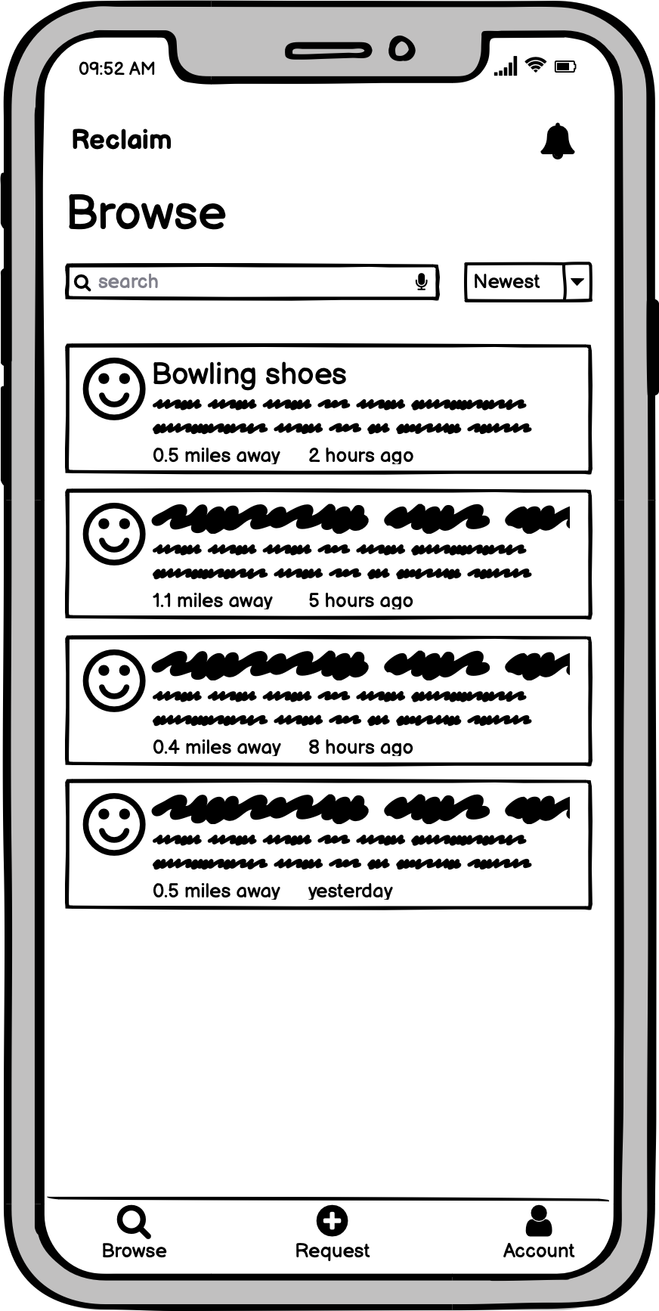
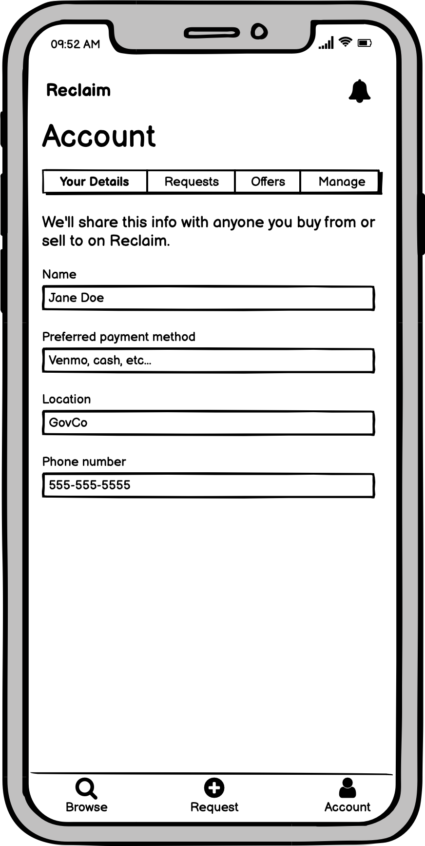
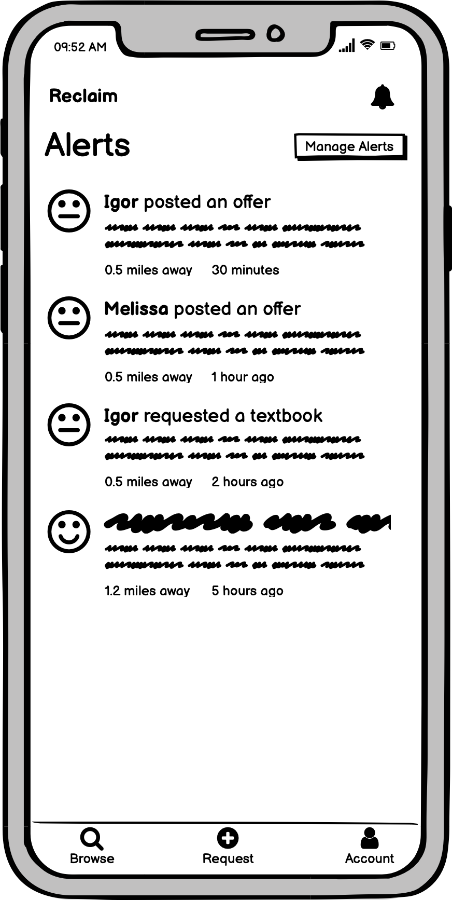
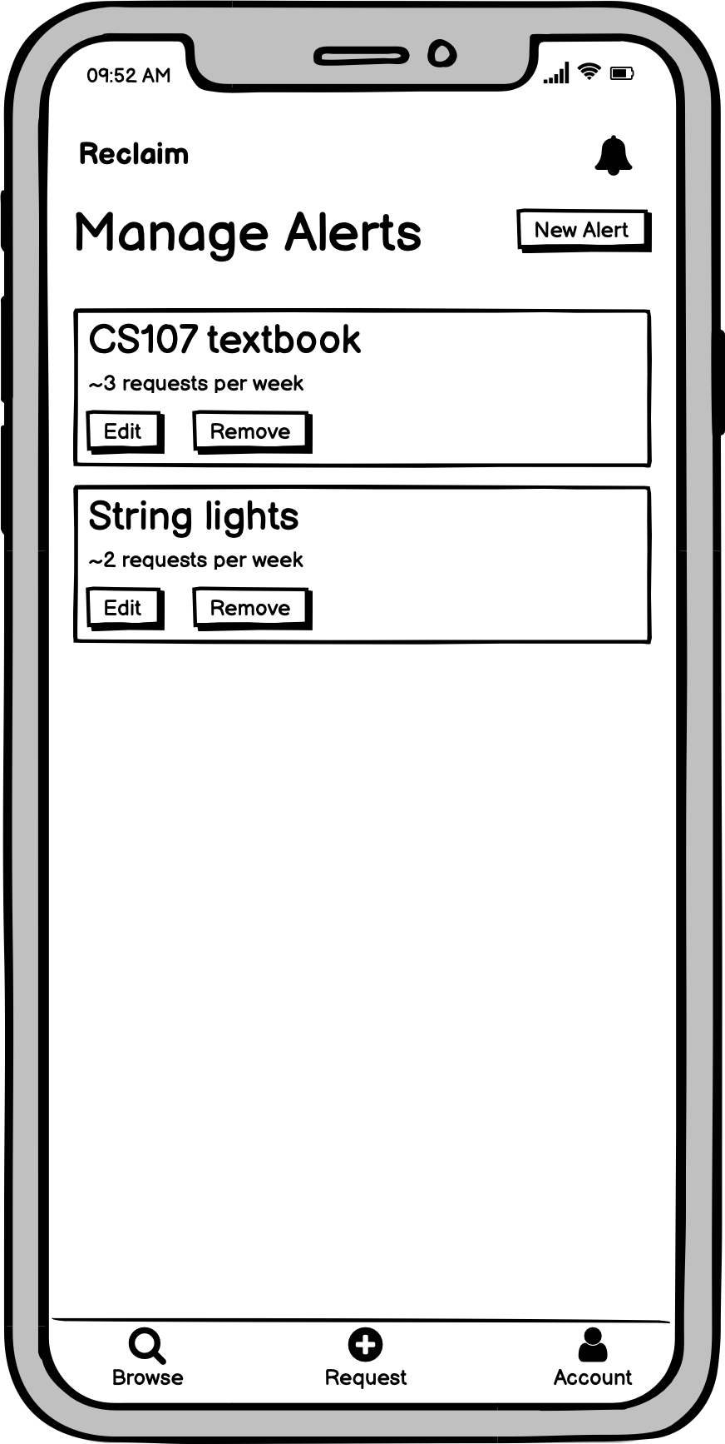
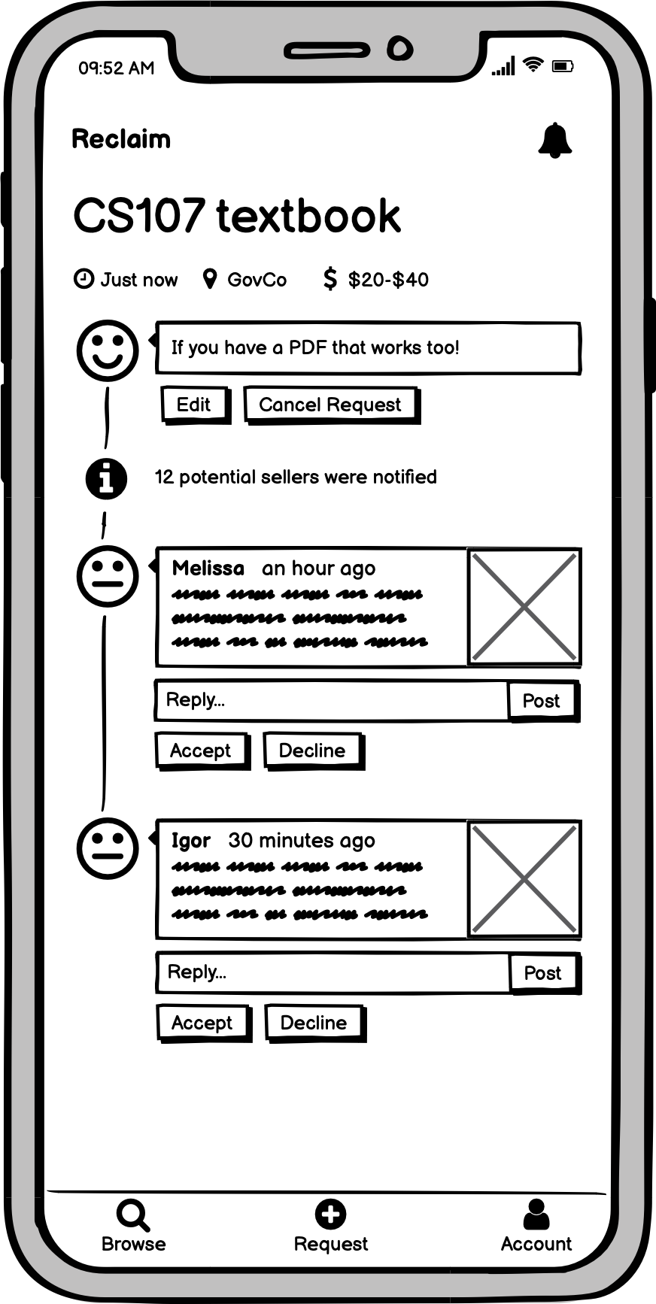
OUR PROTOTYPE

Slide 11
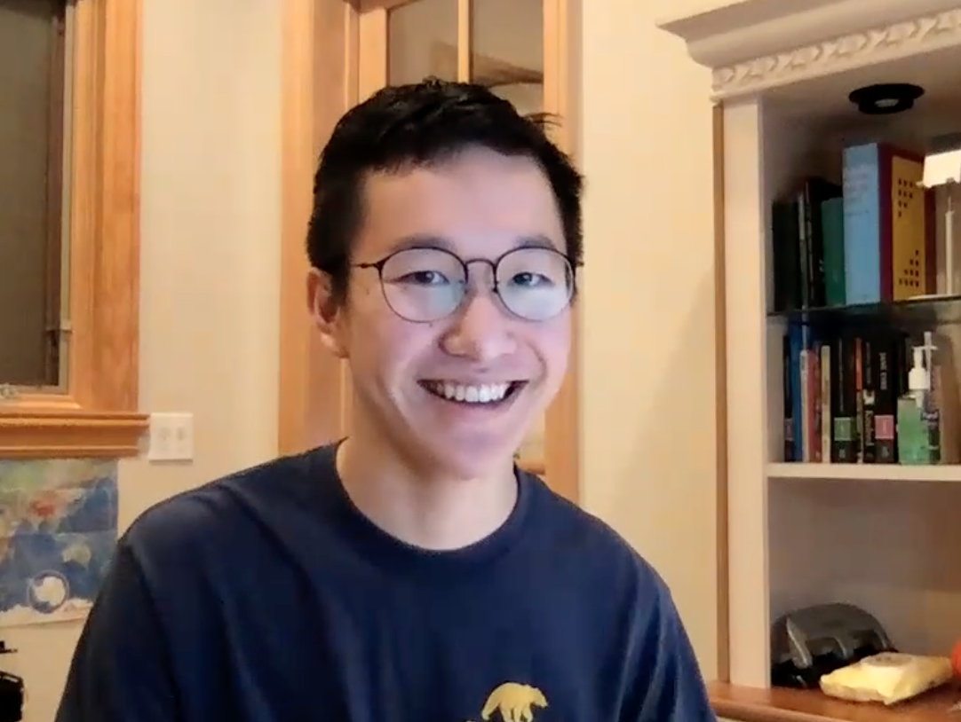
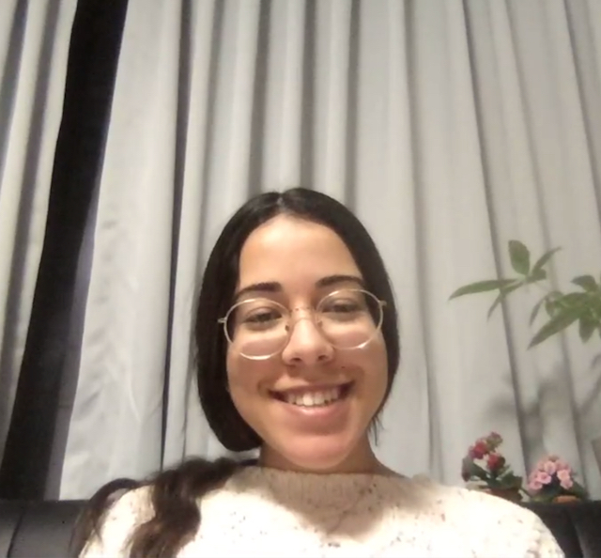
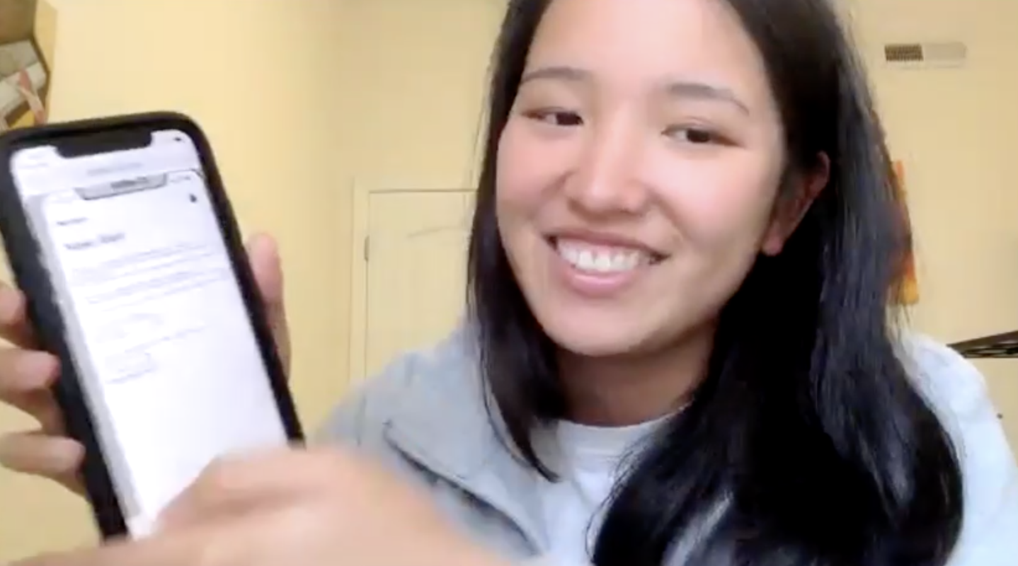

Our Users
JASON
ISABEL
ISABEL
IBTI
JASON
ALLYSSA

Slide 12




Experimental Method
INTRO
DEMO
TASKS
INTERVIEW

Slide 13
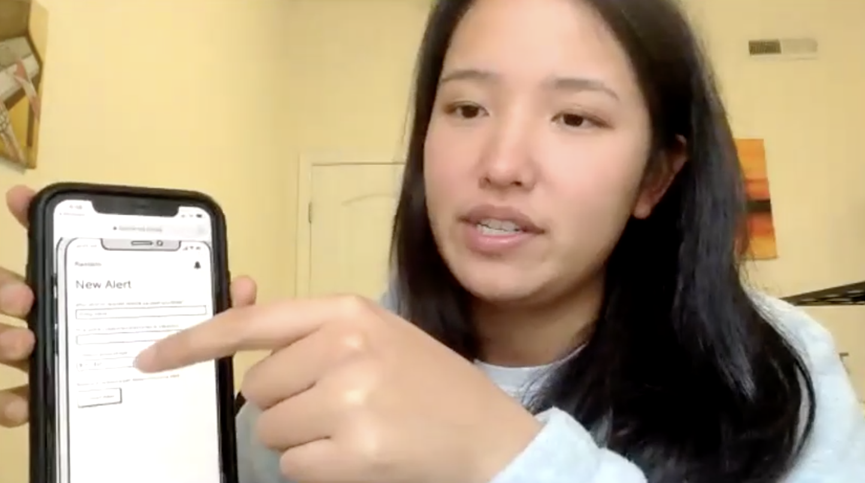
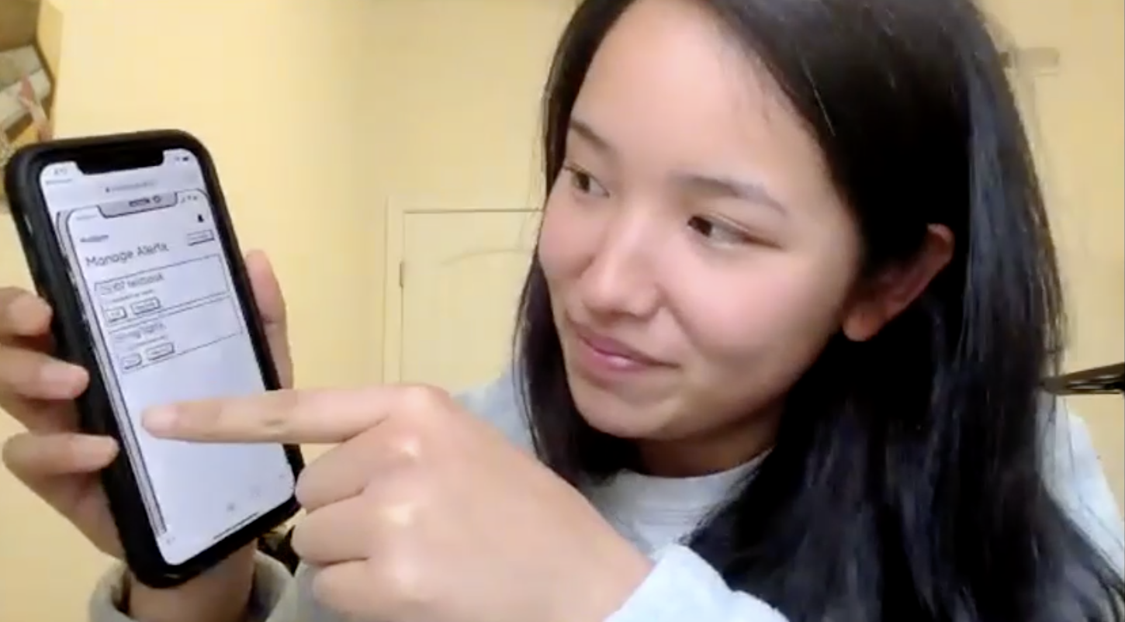
Experimental Protocol

Slide 14
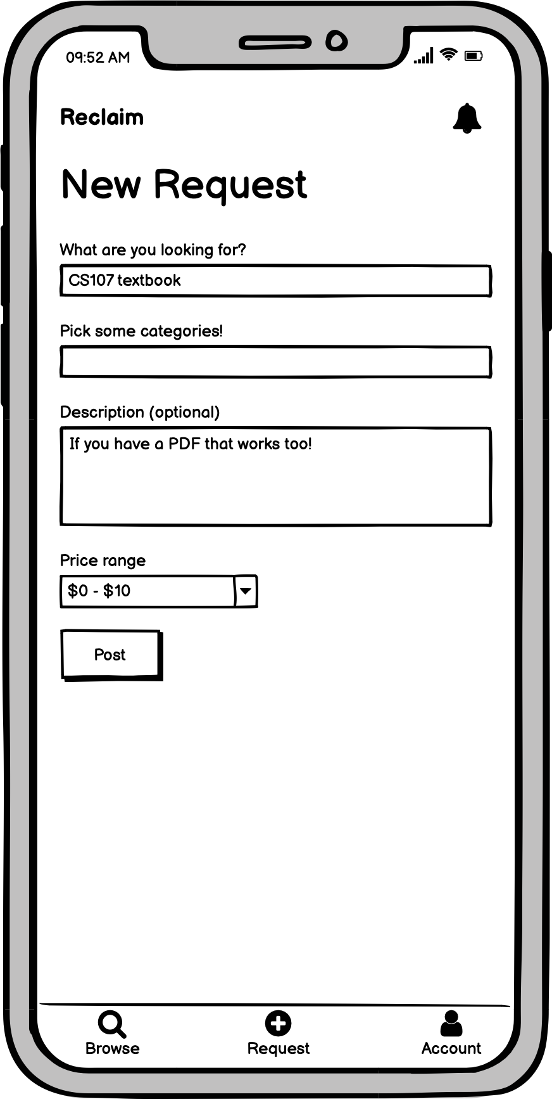
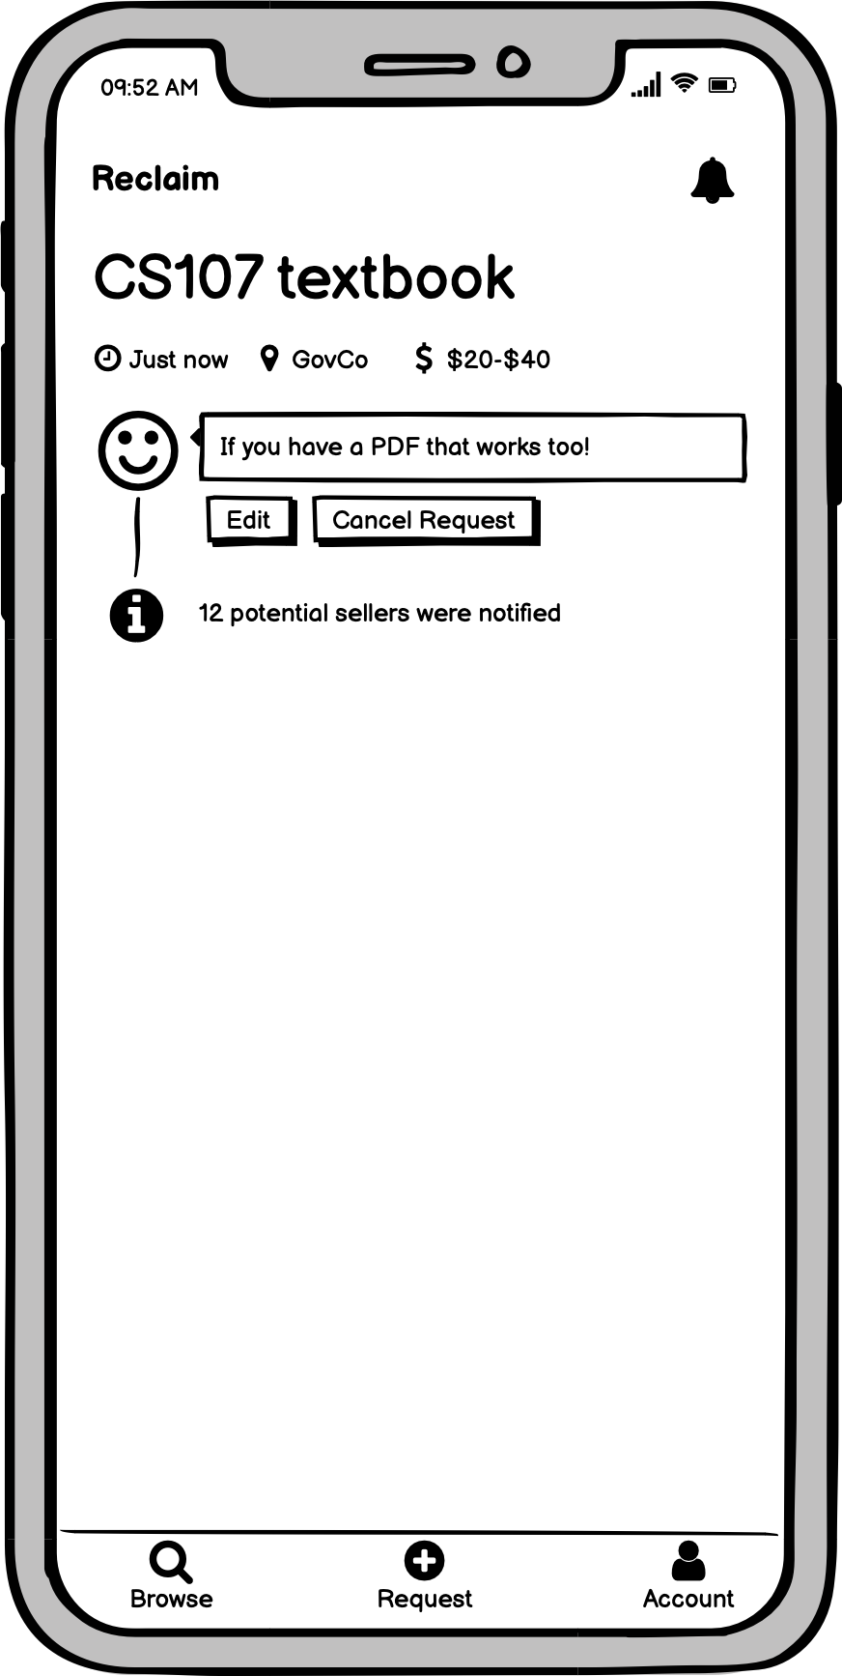
TASK 1: REQUEST AN ITEM

Slide 15
FINDINGS: REQUEST AN ITEM
Quickly performed
Went smoothly
“Easy”

Slide 16
Allyssa
Young adult who lives in a college town
“It’s pretty intuitive… easiest path I’ve ever gone through to get an item”

Slide 17
Jason
High school student
“Really clear, pretty obvious”

Slide 18
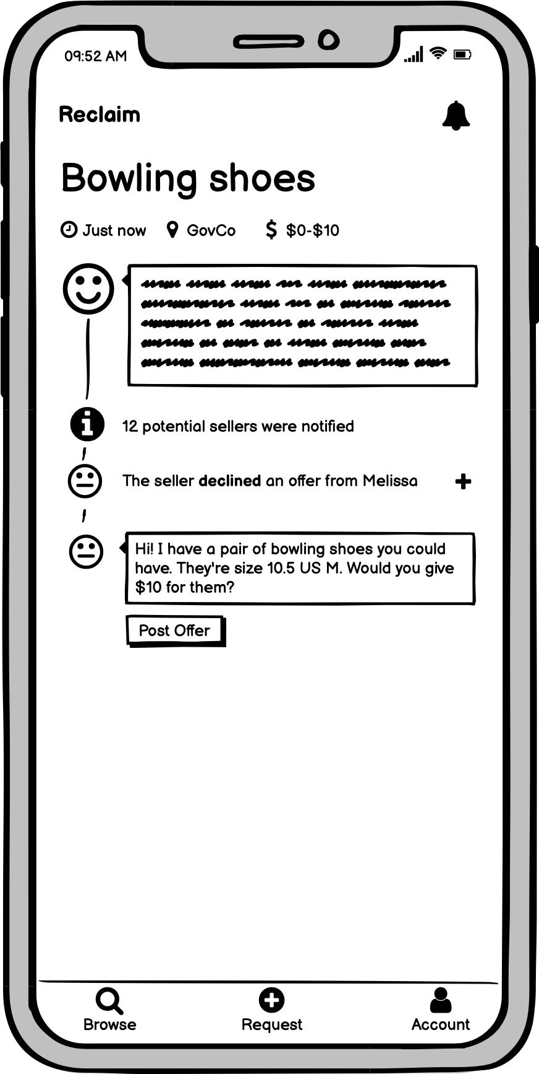
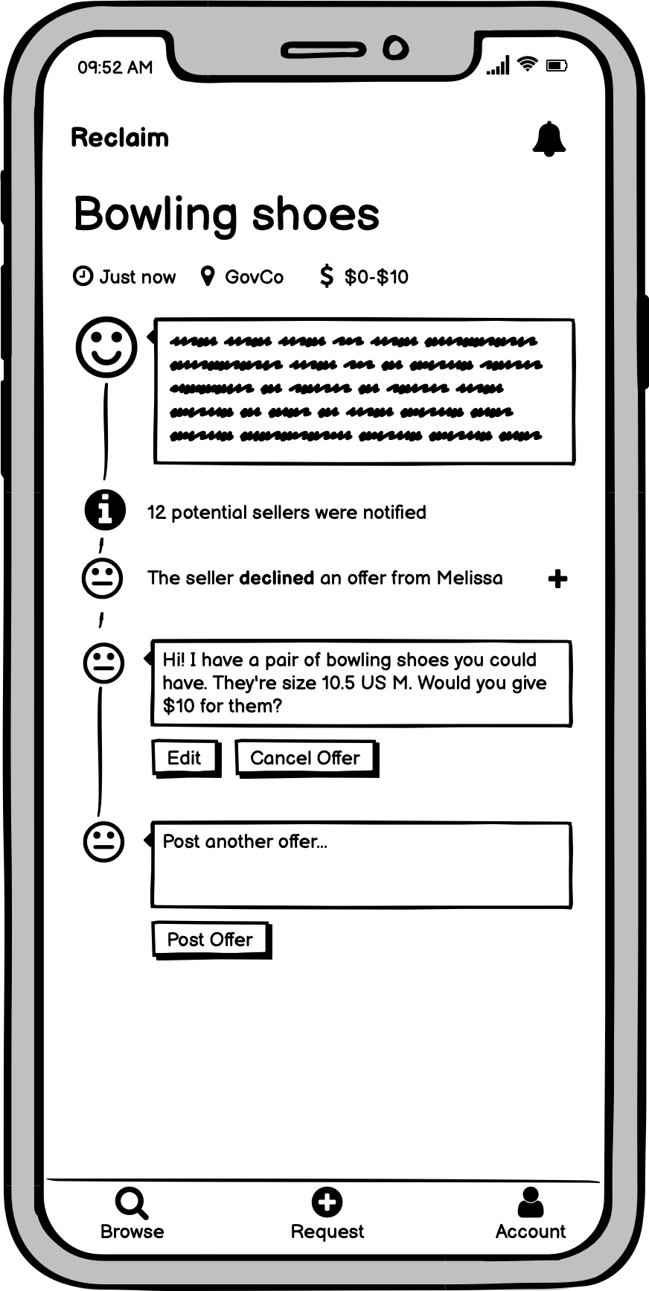
TASK 2: MAKE AN OFFER

Slide 19
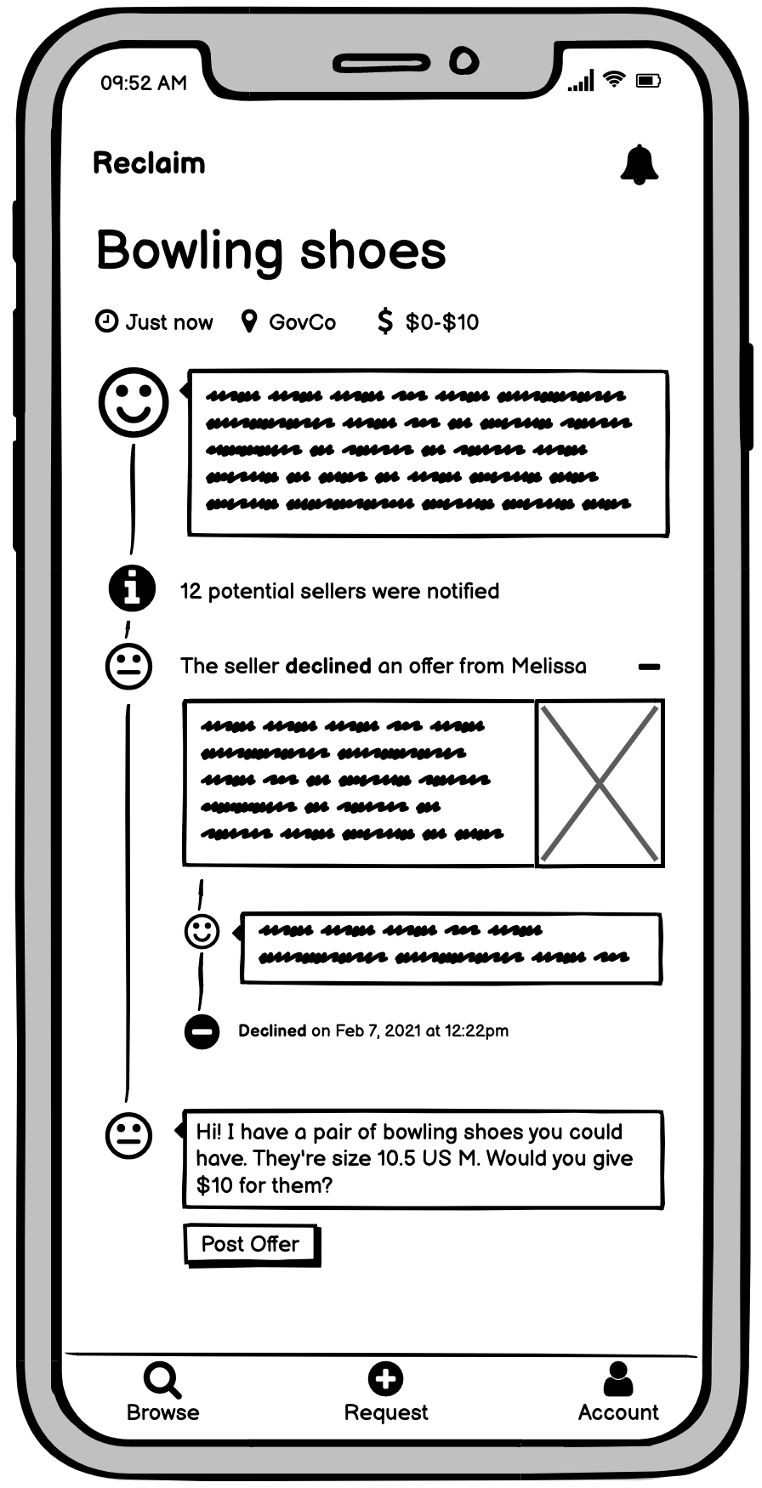
FINDINGS: MAKE AN OFFER
Performed quickly
Went smoothly
Liked viewing declined offer

Slide 20
Ibiti
College student
“I think having a declined offer displayed on the page is useful so that I do not make a similar offer... I think that was amazing.”

Slide 21
Isabel
Graduate student
“It made sense how to post the offer”
“I like how simple it is”

Slide 22
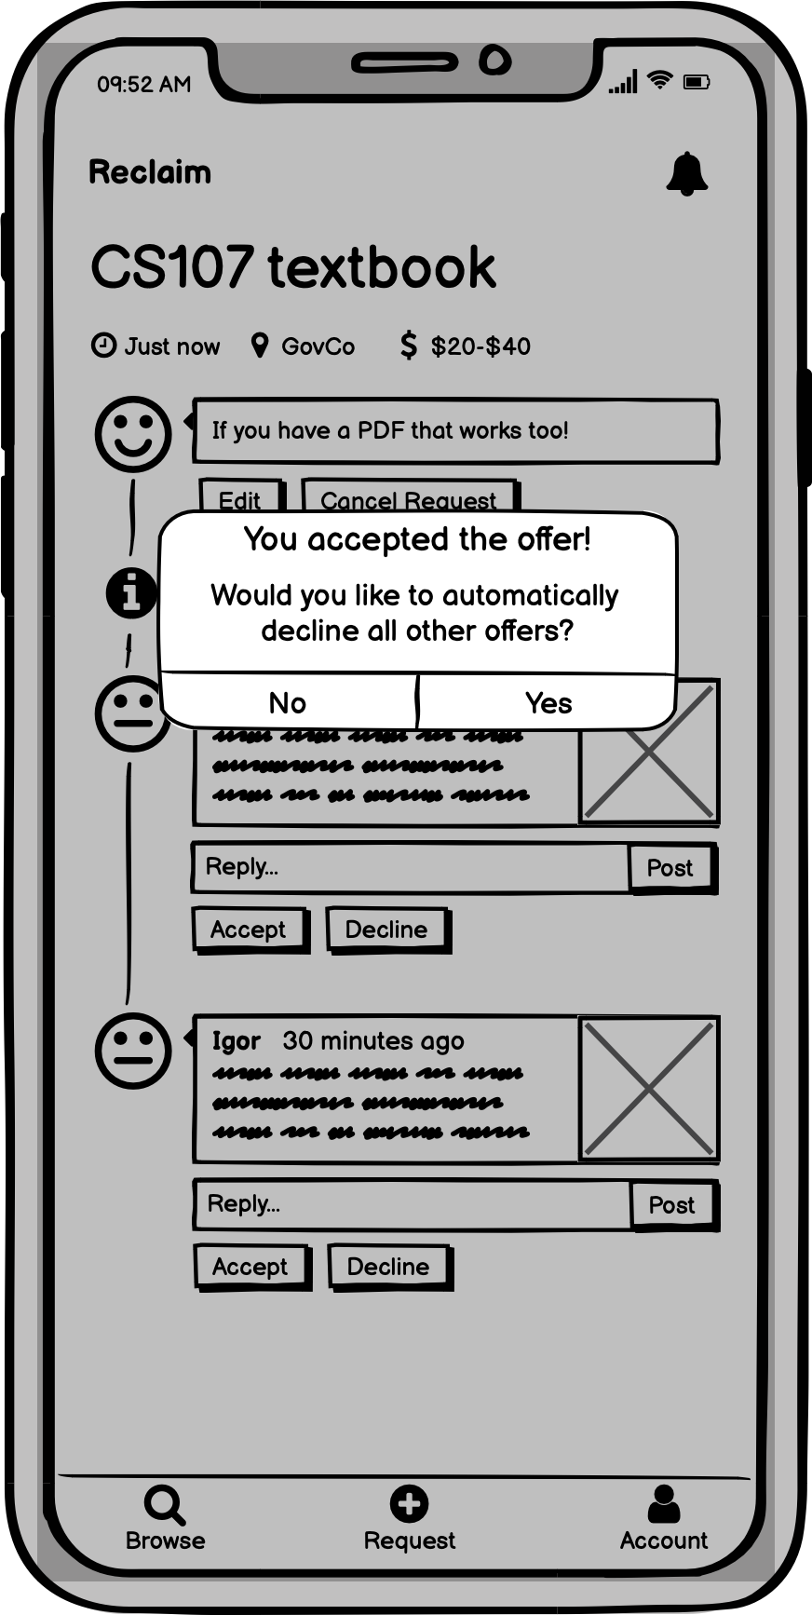
TASK 3: ACCEPT AN OFFER

Slide 23
FINDINGS: ACCEPT AN OFFER
Did not initially click bell icon
Ended up on unintended screens
Tried to reach request using +request button
Liked decline other offers pop-up

Slide 24
Ibiti
College student
“I really appreciate that I could automatically decline all the other offers - that just makes it really convenient”

Slide 25
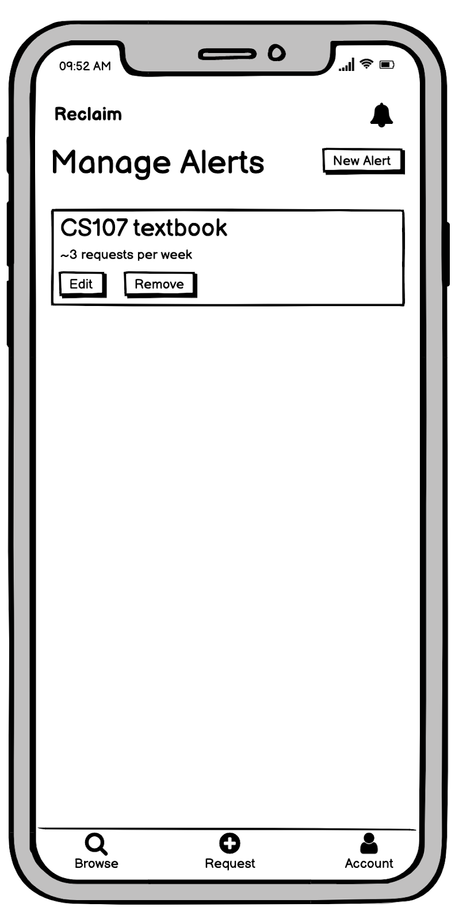
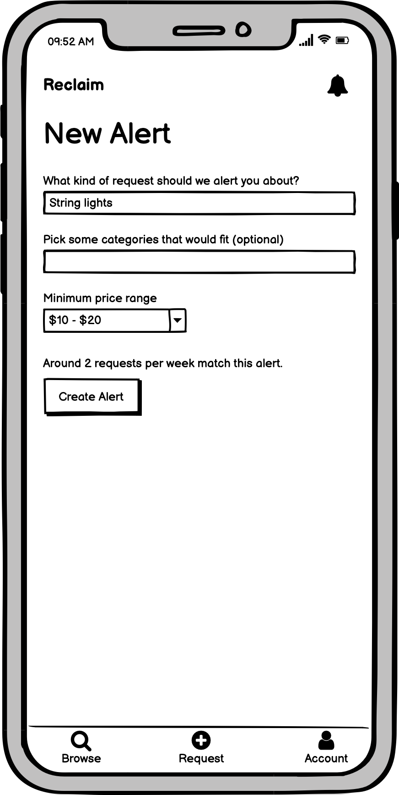
TASK 4: SET UP AUTOMATIC ALERT

Slide 26
FINDINGS: SET UP AUTOMATIC ALERT
Appreciated feature
Performed slowly
Thought alerts set on account page
Confusion about notifications vs alerts

Slide 27
Allyssa
Young adult who lives in a college town
“When it comes to notifications, I think of the bell as incoming, rather than a way to manage it”
“Once I got to the right page, it was intuitive and super easy”

Slide 28
Proposed Interface Changes
Location of alert
management
Use “subscribe” instead of alert

Slide 29
Proposed Interface Changes
Location of alert
management
Modify request button functionality
Use “subscribe” instead of alert
Change request icon

Slide 30
Summary
LO-FI PROTOTYPE
INTERPRETED USER DATA
ACTIONABLE CHANGES

